Slide 1
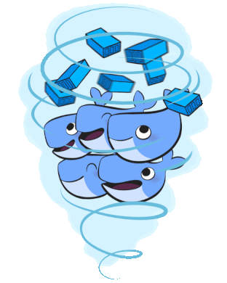

Slide 2

Dockerize your applications
with AWS: ECS/Fargate/EKS
Sergey Pugachev
Solutions Architect, AWS
Notes:
https://www.12factor.net
https://medium.com/open-graphql/top-9-aws-appsync-features-you-didnt-know-about-57224075ffb1

Slide 3
Agenda
Docker & Containers
Container Orchestration: ECS/Fargate/EKS
Cost Optimization

Slide 4
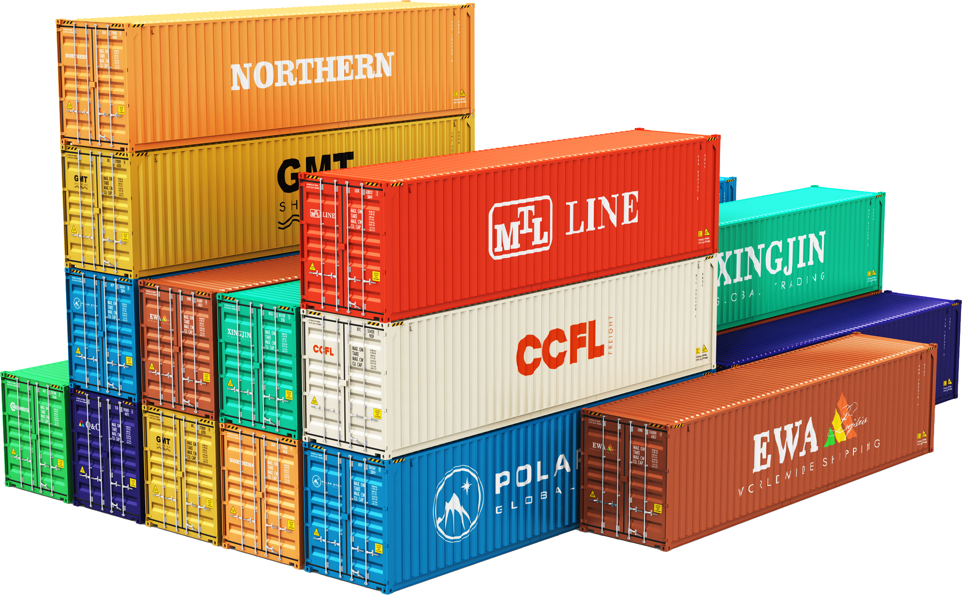
CONTAINERS, CONTAINERS, CONTAINERS

Slide 5


Containers have become the standard for how to ship and run your application in the cloud

Slide 6


Broadest and deepest platform choice
Amazon EC2
Amazon EC2
Virtual server instances in the cloud
Amazon ECS, EKS, and Fargate
Container management service for running Docker on a managed cluster of EC2
AWS Lambda
Serverless compute for stateless code execution in response to triggers
Notes:
Compute is at the core of nearly every AWS customers’ infrastructure, whether it be in the form of instances, containers or serverless compute. We are delivering choice in how you consume compute to support existing applications and build new applications in the way that suits your business and applications needs. And within each of these areas, we are rapidly adding completely new capabilities.

Slide 7






Serverless: less and more
Less
More
Cloud
Compute
Virtual Machine
EC2
Elastic Beanstalk
Fargate
AWS Lambda
Databases
MySQL
MySQL on EC2
RDS MySQL
RDS Aurora
Aurora Serverless
DynamoDB
Storage
Storage
S3
Messaging
ESBs
Amazon MQ
Kinesis
SQS / SNS
Analytics
Hadoop
Hadoop on EC2
EMR
Elasticsearch Service
Athena
Notes:
You have heard us talk about shared responsibility in the past. Simply stated, a shared responsibility model implies there are parts of the system that AWS is responsible for and there are parts of the systems that you as a customer must take responsibility for. In many cases we provide tools and there is a rich ecosystem of open source and commercial products that makes it easier for all of you to own your side of the responsibility box.
There is no one hard line on where this line is drawn between the two parts of shared responisbility. One one side of the spectrum you can leverage the power and flexibility of EC2 to run your own database. You can use something like RDS to simplify the management of the database or use RDS Aurora to completely offload the database storage infrastructure to an AWS managed backend. Alternatively you can move to a fully managed database like DynamoDB where you create tables, put data in those tables, and query the data. There is no infrastructure to manage. QoS is part of the the database service with sufficient knobs and dials to give you the right level of control.
The question we keep asking ourselves is: how can we draw this line in a way that allows our customers to innovate on business problems, but makes the underlying infrastructure less visible. Any time you spend coraling infrastructure is undifferentiated heavy lifting. Over the last 12 years as more and more people start in the cloud or move major applications to the cloud, this definition of "undifferentiated havy lifting has evolved"

Slide 8


Slide 9
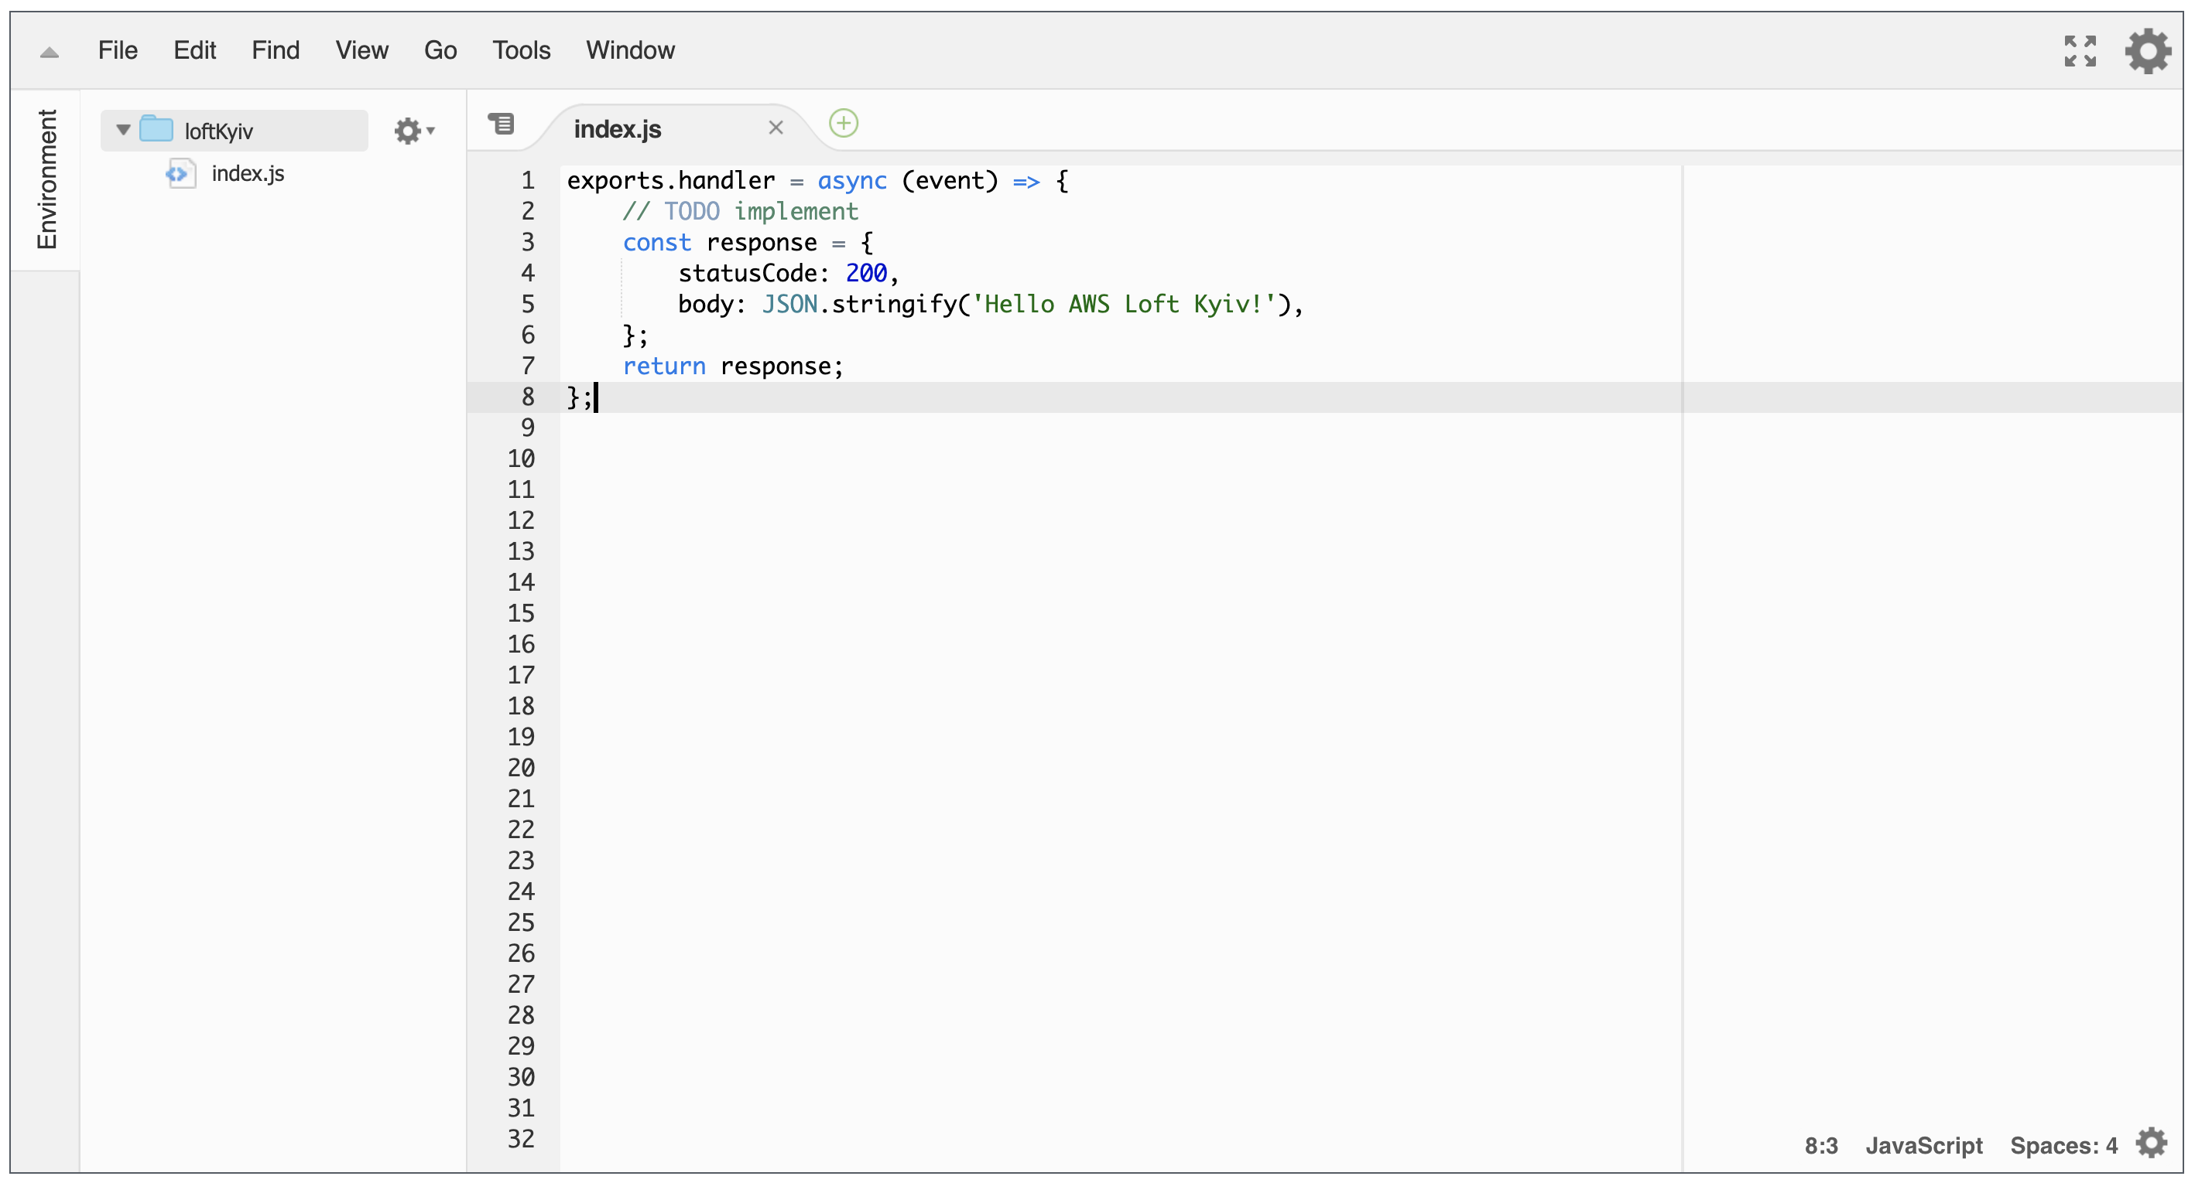
Lambda

Slide 10
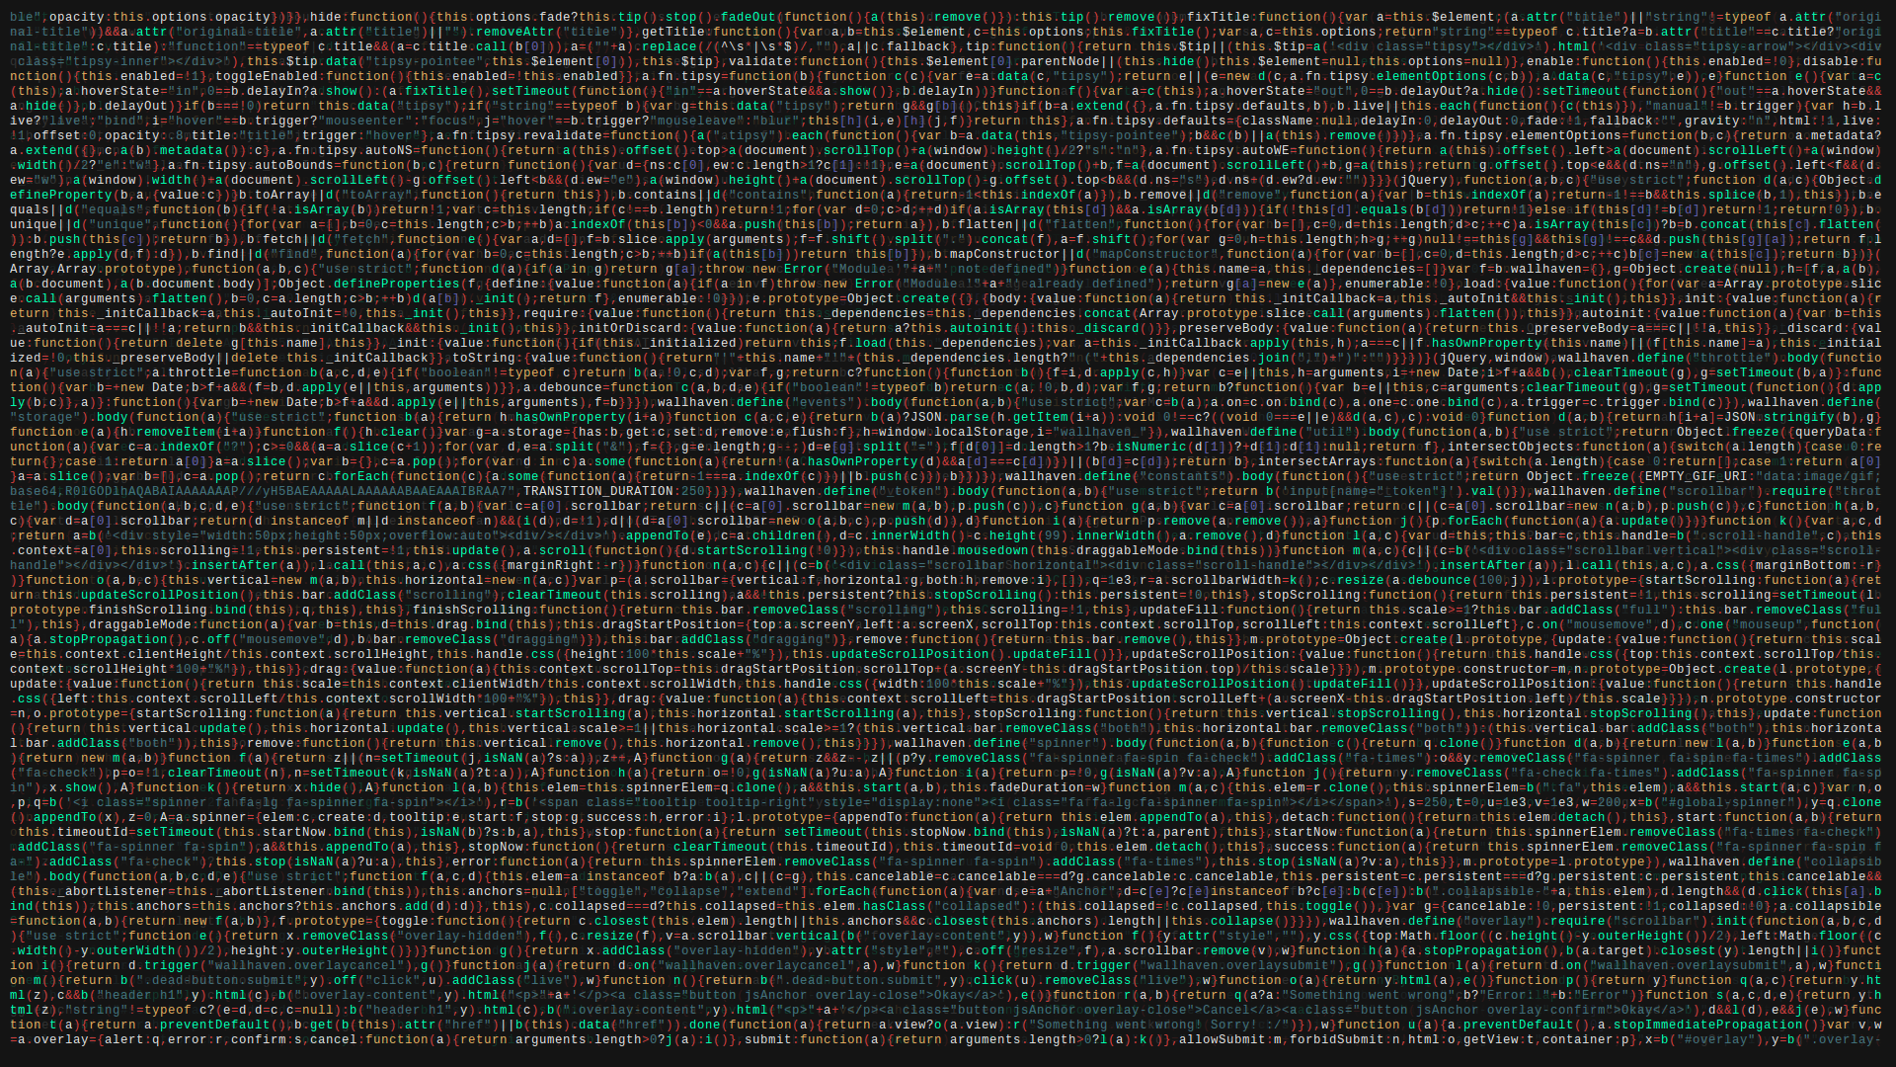
1. Containers

Slide 11
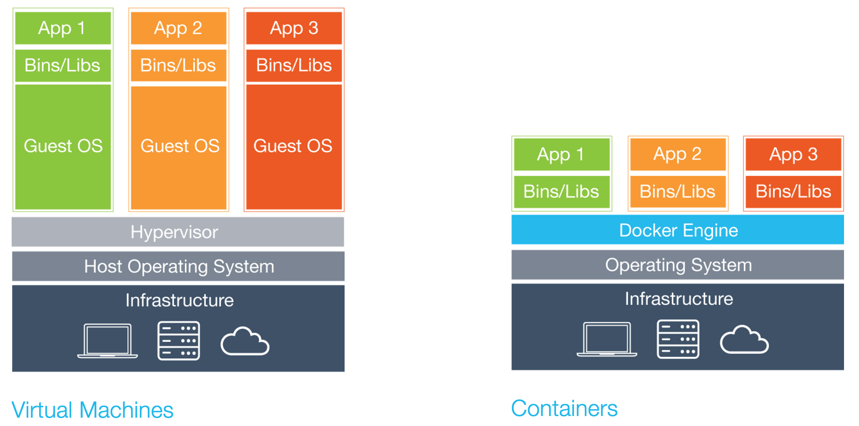
Notes:
Нет оверхеда

Slide 12
App
JavaScript
const http = require('http'); const server = http.createServer((request, response) => { response.writeHead(200, {"Content-Type": "text/html"}); response.end("<h1>Hello Docker!</h1>\n"); });
server.listen(3000);

Slide 13
Dockerfile
Docker
FROM node:12-alpine // Which base image do I use?
EXPOSE 3000 // Which ports should I open?
ADD . /app // What files do I need?
WORKDIR app // Where do I run commands from?
RUN npm install // How do I install dependencies?
CMD ["npm", "start"] // How do I start the application?

Slide 14
Build & run the container
Bash
# build the container
$ docker build -t spugachev .
# push to registry
$ docker push spugachev
# try it out!
$ docker run -p 3000:3000 -d spugachev
Notes:
$(aws ecr get-login --no-include-email --region us-east-1)
docker build -t spugachev .
docker tag spugachev:latest 273595204085.dkr.ecr.us-east-1.amazonaws.com/spugachev:latest
docker push 273595204085.dkr.ecr.us-east-1.amazonaws.com/spugachev:latest

Slide 15
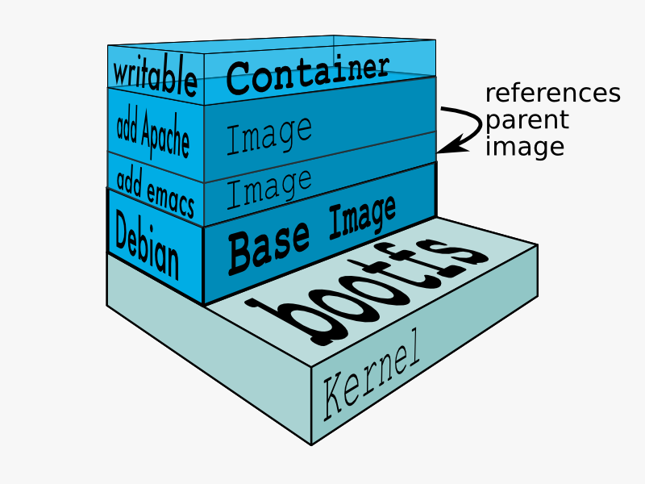
Docker Image

Slide 16
Docker
Container
Dockerfile
run
Container
Image
build
run
run
Container

Slide 17

“Write programs that do one thing, and do it well. Write programs that work together”
UNIX
- Unix Philosophy
Notes:
Microservices take the Unix philosophy to your application design. Write programs that do one thing, and do it well. Write programs that work together. Sounds familiar right?

Slide 18
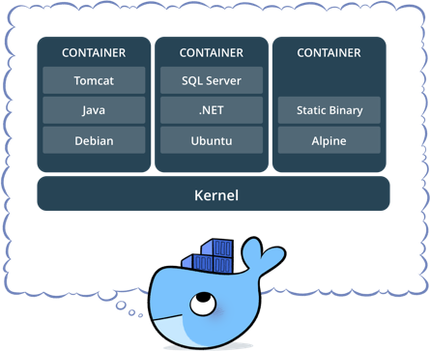

Slide 19
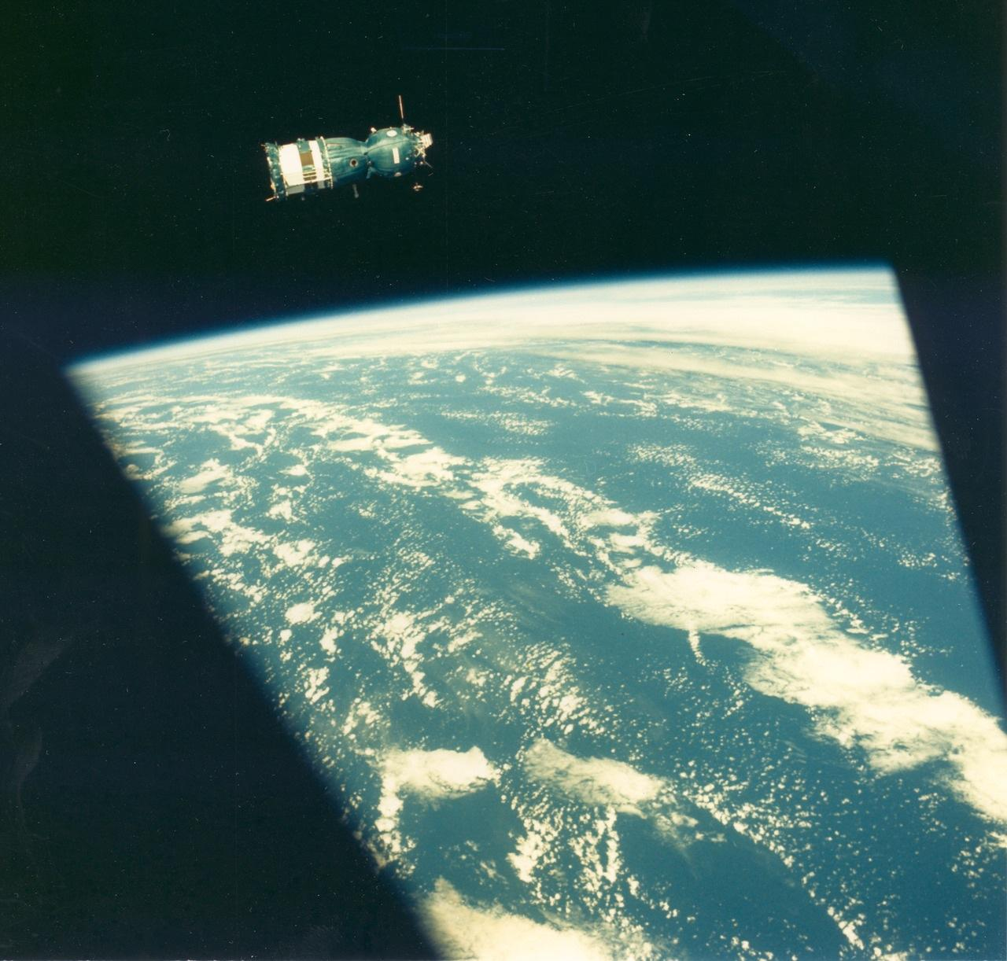
DEMO
Docker & Containers

Slide 20
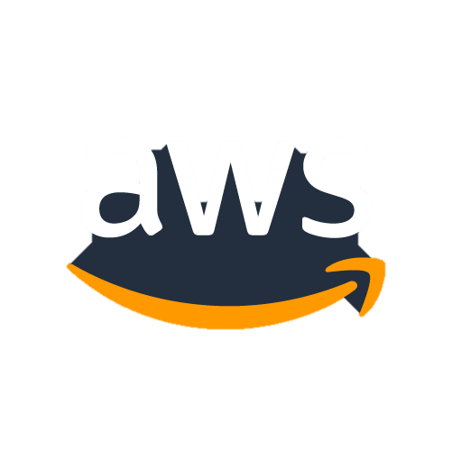
Managing many containers is hard
Notes:
…. Where your application is spread across a number of hosts and is very difficult to keep track of what is running where.

Slide 21
2. Container Orchestration

Slide 22
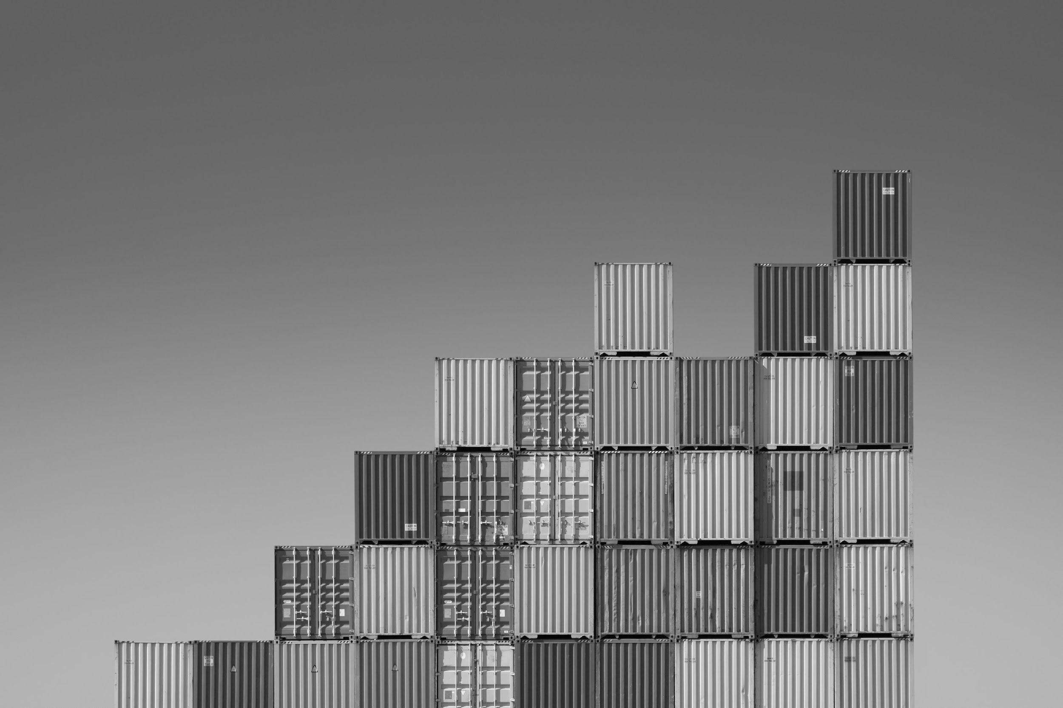
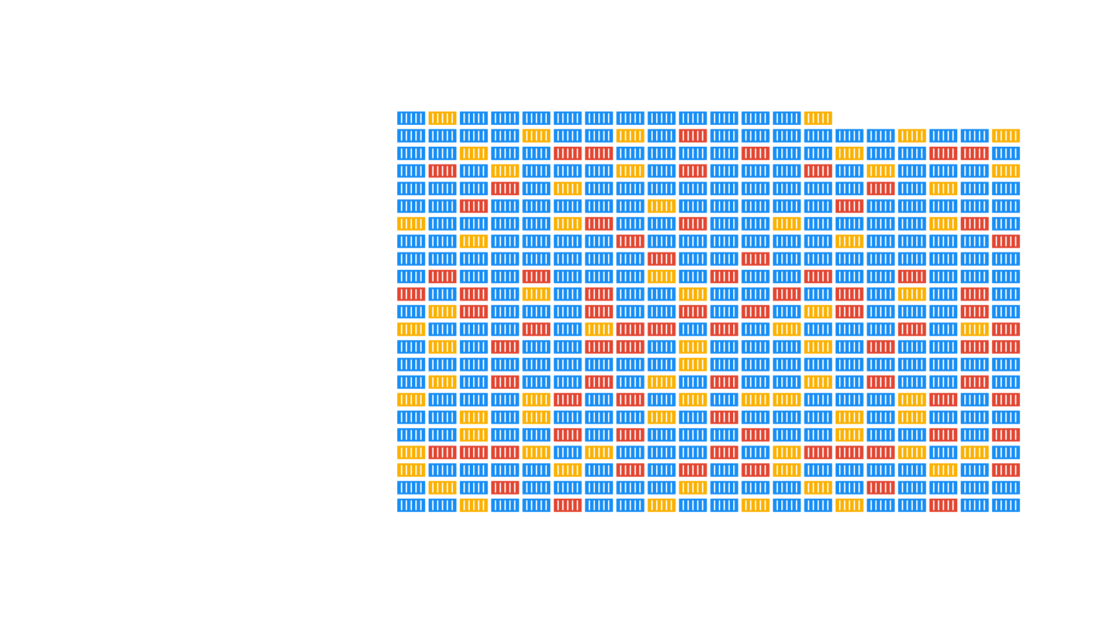
Provisioning
Updates
Scaling
High availability
Networking
Load balancing
Storage management
Service discovery
Cluster Orchestration
Notes:
Windows и Linux сервера, Production и Staging, разные датацентры

Slide 23
Containers orchestration in AWS
Amazon ECS
Amazon EKS
Fargate

Slide 24
ECS
Integration with entire AWS platform
ALB, Auto Scaling, Step Functions, Batch, CloudFormation, CloudTrail, CloudWatch Events, CloudWatch Logs, CloudWatch Metrics, ECR, EC2 Spot, IAM, NLB, Parameter Store
1
2
Scales to support clusters of any size
Service integrations (like ALB and NLB) are at container level
Easiest way to deploy and manage containers
3

Slide 25
Fargate
A MANAGED PLATFORM
A MANAGED PLATFORM
A MANAGED PLATFORM
No infrastructure
Manage everything at container level
Launch quickly
Scale easily
Containers on demand
Resource based pricing
Notes:
Last but not least

Slide 26
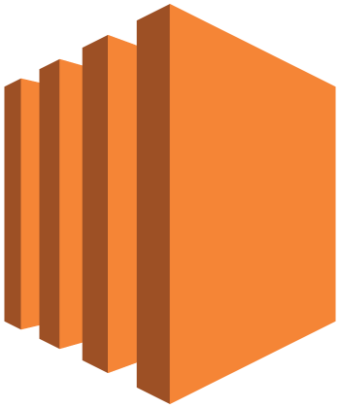

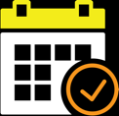


EKS
Master
Etcd
Managed Kubernetes control plane
Highly available
Automated version upgrades
Integration with other AWS services
Managed Kubernetes on AWS

Slide 27

57%
of Kubernetes runs on AWS today — Cloud Native Computing Foundation

Slide 28

AWS Managed
Controller
Controller
Controller
Customer Account
Workers
Workers
Workers
Availability
Zone 1
Availability
Zone 2
Availability
Zone 3
Notes:
Explain the Shared responsibility model

Slide 29
So you want to run a (managed) container on
AMAZON CONTAINER SERVICES
1
Choose your orchestration tool
ECS
EKS
2
Choose your launch type
EC2
Fargate
EC2

Slide 30
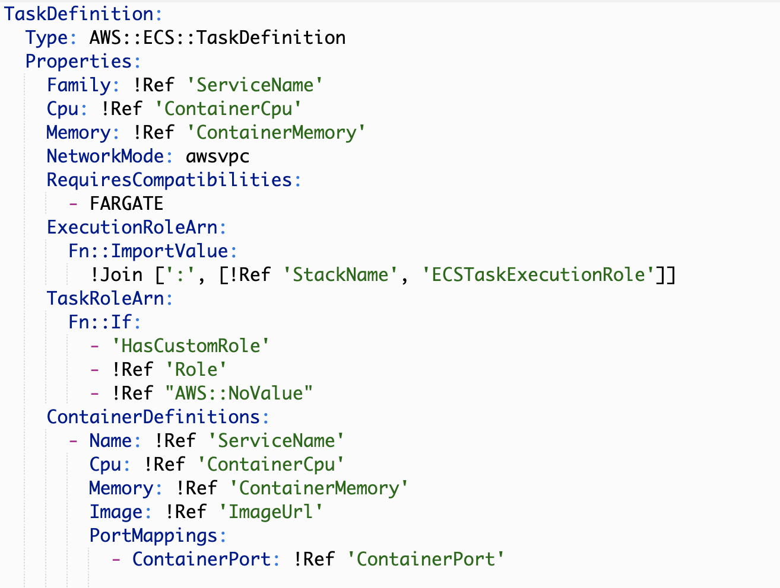
AWS CloudFormation
Notes:
TaskDefinition:
Type: AWS::ECS::TaskDefinition
Properties:
Family: !Ref 'ServiceName'
Cpu: !Ref 'ContainerCpu'
Memory: !Ref 'ContainerMemory'
NetworkMode: awsvpc
RequiresCompatibilities:
- FARGATE
ExecutionRoleArn:
Fn::ImportValue:
!Join [':', [!Ref 'StackName', 'ECSTaskExecutionRole']]
TaskRoleArn:
Fn::If:
- 'HasCustomRole'
- !Ref 'Role'
- !Ref "AWS::NoValue"
ContainerDefinitions:
- Name: !Ref 'ServiceName'
Cpu: !Ref 'ContainerCpu'
Memory: !Ref 'ContainerMemory'
Image: !Ref 'ImageUrl'
PortMappings:
- ContainerPort: !Ref 'ContainerPort'

Slide 31
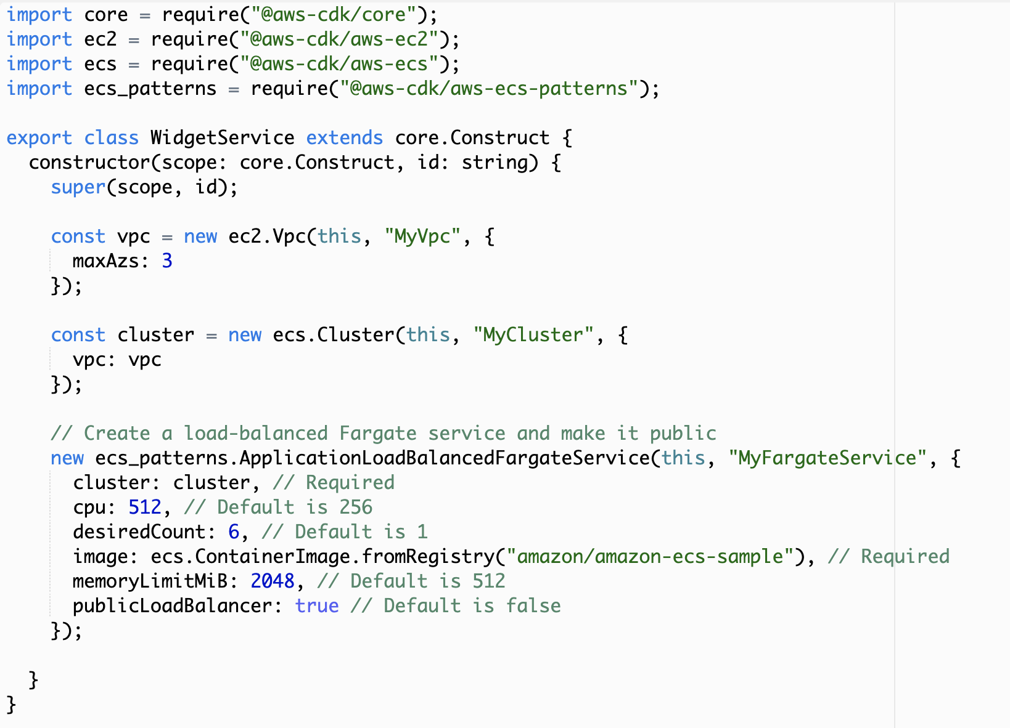
AWS CDK
Notes:
import core = require("@aws-cdk/core");
import ec2 = require("@aws-cdk/aws-ec2");
import ecs = require("@aws-cdk/aws-ecs");
import ecs_patterns = require("@aws-cdk/aws-ecs-patterns");
export class WidgetService extends core.Construct {
constructor(scope: core.Construct, id: string) {
super(scope, id);
const vpc = new ec2.Vpc(this, "MyVpc", {
maxAzs: 3
});
const cluster = new ecs.Cluster(this, "MyCluster", {
vpc: vpc
});
// Create a load-balanced Fargate service and make it public
new ecs_patterns.ApplicationLoadBalancedFargateService(this, "MyFargateService", {
cluster: cluster, // Required
cpu: 512, // Default is 256
desiredCount: 6, // Default is 1
image: ecs.ContainerImage.fromRegistry("amazon/amazon-ecs-sample"), // Required
memoryLimitMiB: 2048, // Default is 512
publicLoadBalancer: true // Default is false
});
}
}

Slide 32
DEMO
ECS & Fargate

Slide 33
3. Cost Optimization

Slide 34
Amazon EC2 purchase options
On-Demand
Pay for compute capacity the second with no long-term commitments
Spiky workloads, to define needs
Reserved Instances
Make a 1 or 3-year commitment and receive a significant discount off On-Demand prices
Committed & steady-state usage
Spot Instances
Spare EC2 capacity at savings of up to 90% off On-Demand prices
Fault-tolerant, flexible, stateless workloads

Slide 35
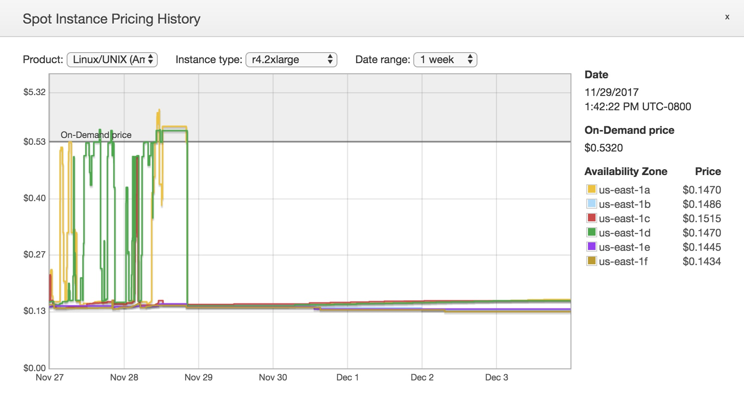
New Pricing Model
New smooth pricing November 2017

Slide 36
What about interruptions?
Minimal interruptions Over 95% of the instances were not interrupted in the last 3 months
The work you are doing to make your applications fault-tolerant also benefits Spot
Spot is optimized for stateless, fault-tolerant, or flexible workloads.
Any application that can can have part or all of the work, paused and resumed or restarted, can use Spot.
Check for 2-minute instance termination notice via instance metadata or CloudWatch Events and automate by:
Checkpointing
Draining from ELB
Using stop-start and hibernate to restart faster

Slide 37
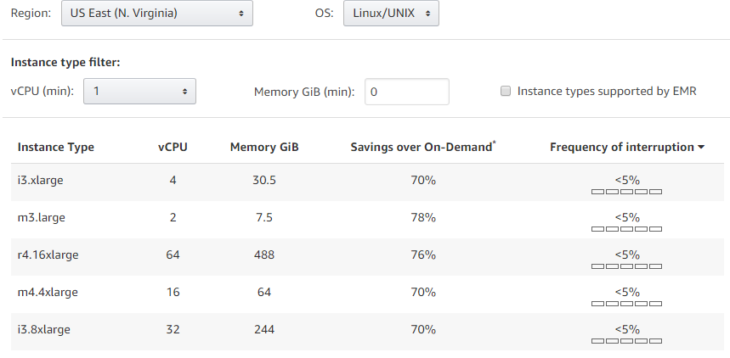
Spot Instance Advisor

Slide 38

> Thank you!

Slide 39
